Slide 1
Product Research Lightning Talk
sdmay25-26 Bryce Rega, Marek Jablonski, Gavin Patel, Jonah Frosch, Long Yu
October 1st, 2024

Slide 2
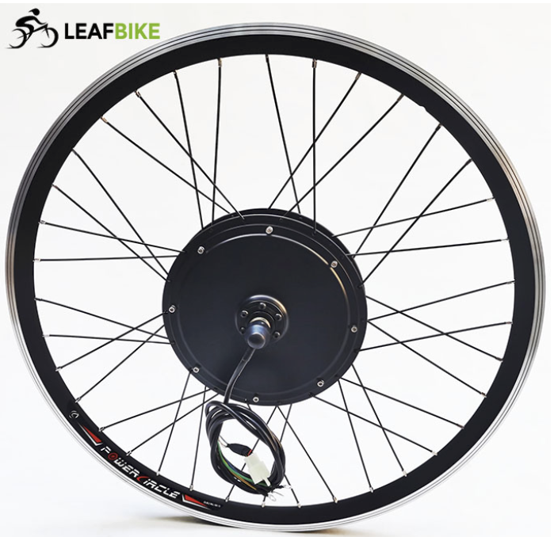
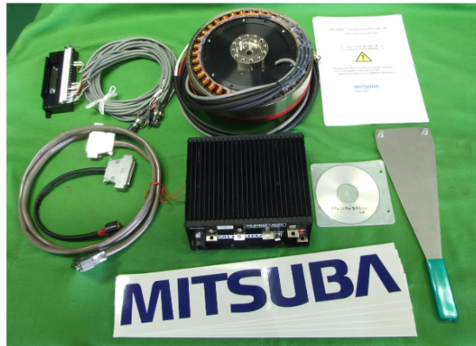
Project Overview
Custom High Voltage Motor Controller
Low Total cost for controller when compared to market options
Develop a GUI for interfacing and configuring controller
Compatible with many different applications

Slide 3
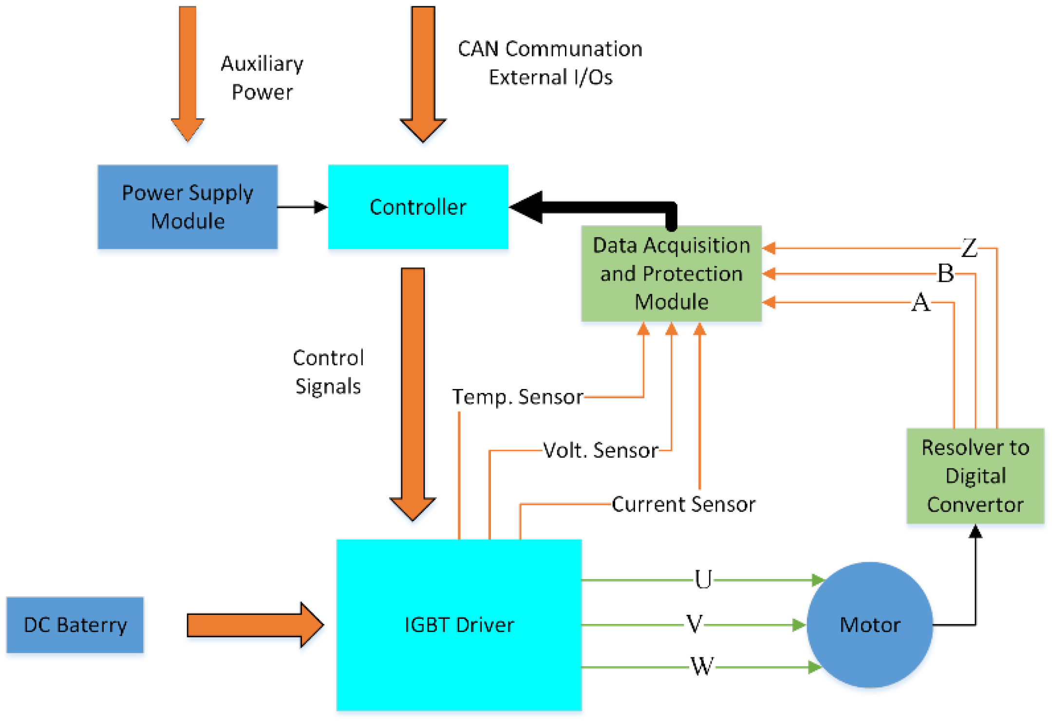
In this project will we be designing the architecture and implementation of a motor controller for lightweight automotive use.

Slide 4
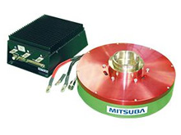
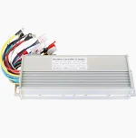
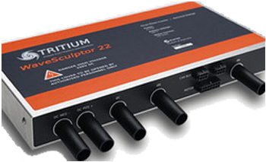
Related Products
Mitsuba 2096-III
Tritium WaveSculptor22
Komodo Brushless Motor Speed Controller DC
Very expensive
Designed specifically for Mitsuba motors
Very difficult to use
Doesn't support common features (CAN, cruise)
Very expensive
Jack of all trades, master of none
Useful documentation
Fairly easy to configure for specific applications
Relatively affordable
Doesn't reach high enough voltage for some applications
Built for scooters
Lacks configurations

Slide 5
Market Gap – Opportunities
Lack of proper documentation makes integrating motor controllers difficult
Many of these are black boxes that makes troubleshooting difficult
Users want to easily implement their controllers but often can't
Motor controllers for higher power applications have affordability issues
EV bikers may have issues modifying/constructing bikes on budget
Solar vehicle teams need to raise large amounts of money for motor controllers alone despite needing funds for other components/services
Most motor controllers are either difficult to configure or do not allow for custom configurations
Different vehicles have different needs depending on physical/electrical specs
Users are forced to design around motor controllers

Slide 6
New Ideas
Configurations easily accessible and well documented
Customizing the motor controller allows easy integration for different applications
Clear documentation leads users to understand the expected results
Full Plug-in diagnostics
Allows for better troubleshooting
Documentation on troubleshooting measures reduces frustration
Design the controller with affordability in mind

Slide 7
Conclusion
This project can aim to achieve a fully functioning lightweight automotive motor controller through proper documentation, using affordable components, and making plug in diagnostics a priority to troubleshoot any issues the controller will have. These features will close the gap between our project and what is currently on the market tremendously, creating a viable alternative to current automotive motor controllers.

